Slide 1
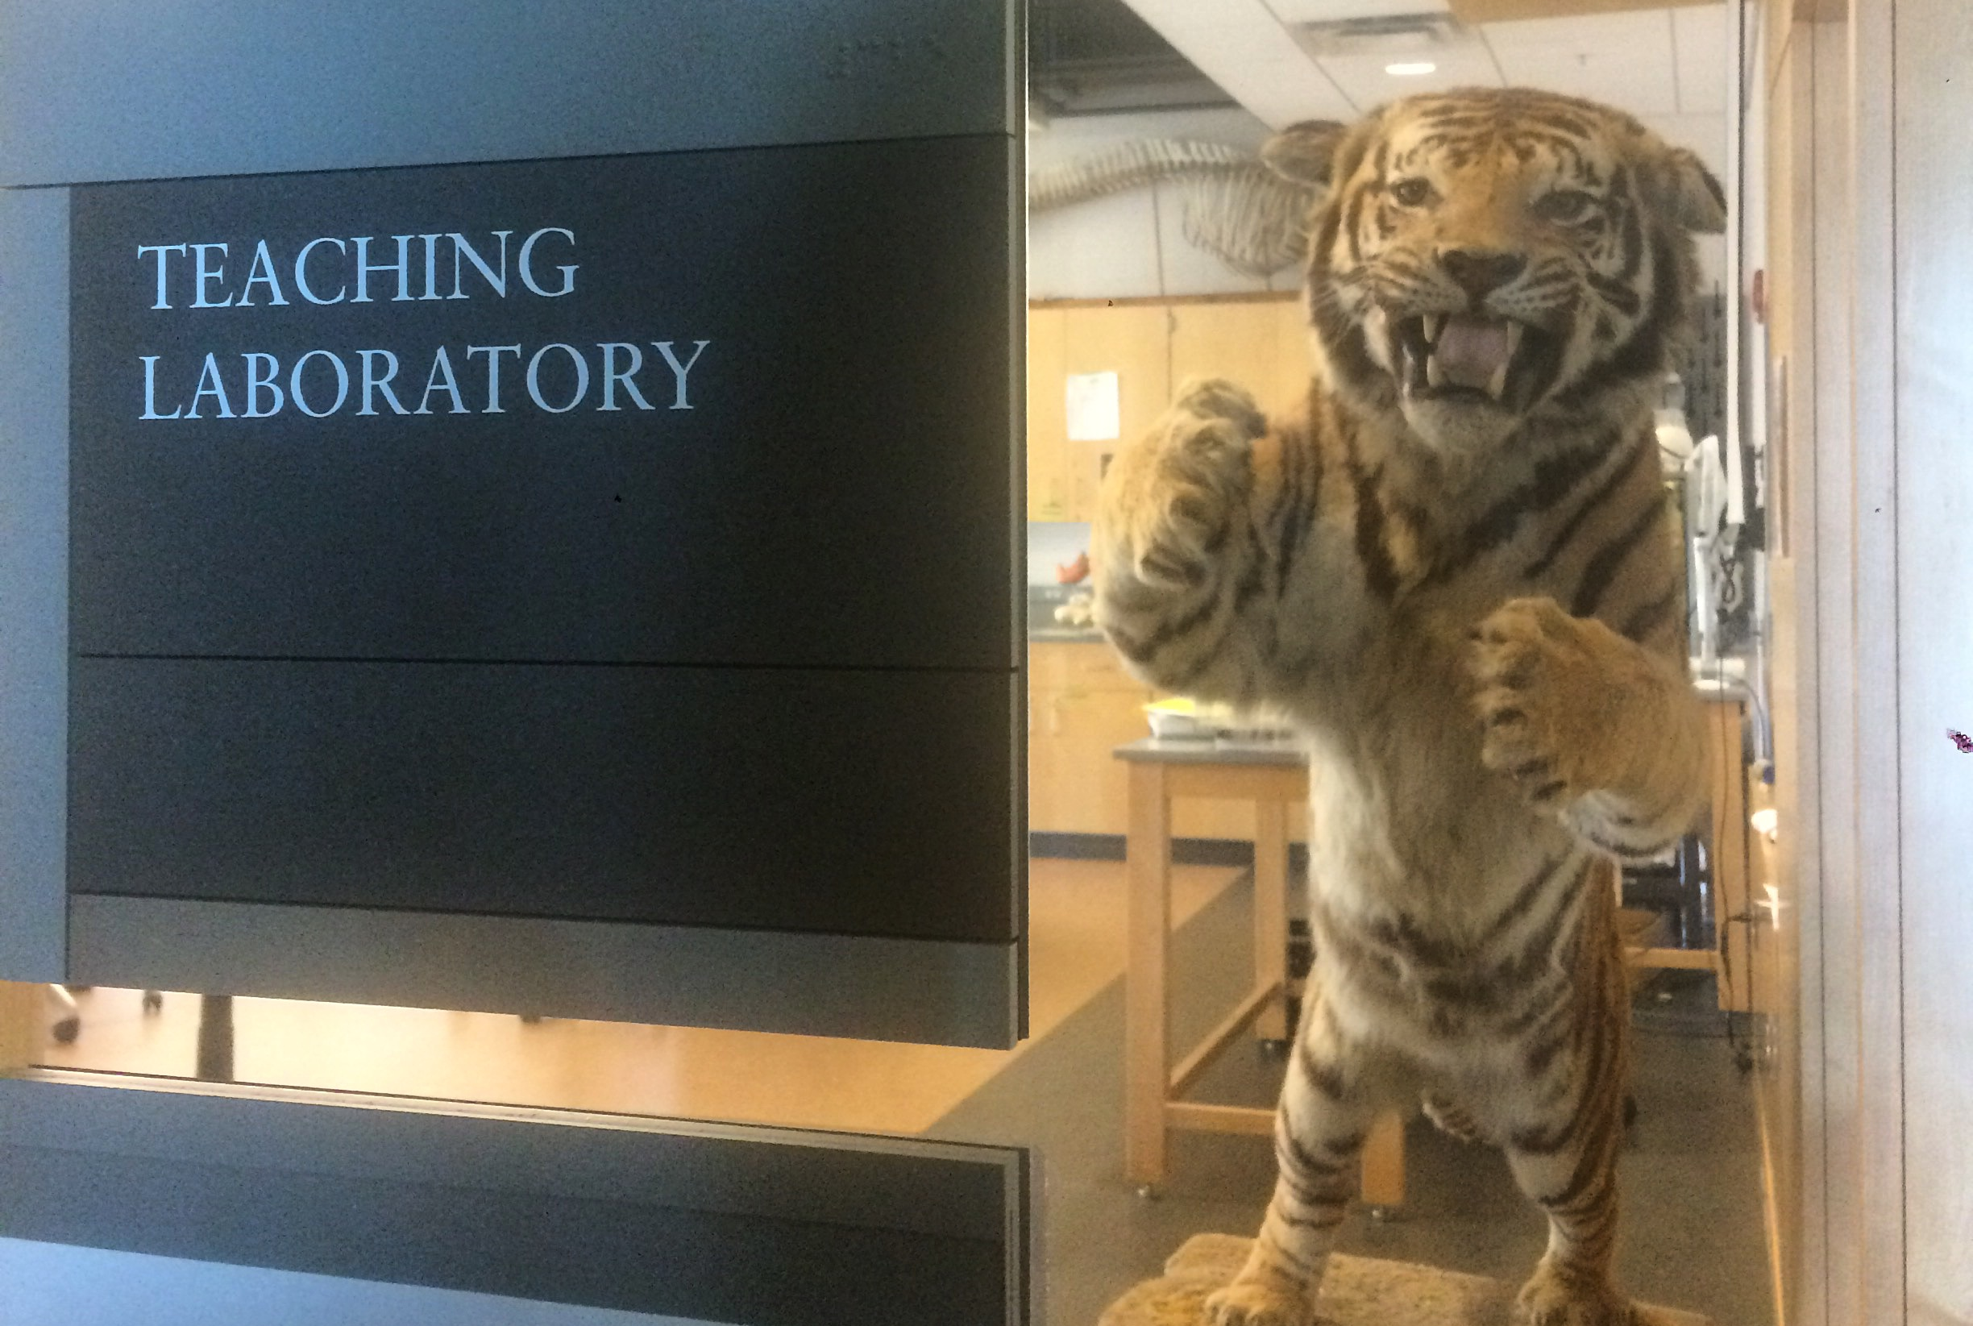
Evidence-based Undergraduate Teaching in STEM:
I took a MOOC and it was good
Kristen M DeAngelis, PhD
Sept 18, 2018
Notes:
100,000 M. xanthus vs 10 million E. coli

Slide 2
Learning Objectives
Describe the 8-week CIRTL MOOC, An Introduction to Evidence-Based Undergraduate STEM Teaching.
Identify some tools that you can use to improve STEM learning outcomes for undergraduate students.
Feel enabled to incorporate one or two new ideas into your teaching.

Slide 3
An Introduction to Evidence-Based Undergraduate STEM Teaching
CIRTL is the Center for Integrated Research, Teaching and Learning (CIRTL.net)
  Network of R-1 institutions with a shared goal of improving college and university teaching
  Includes UMass via TEFD
Massive Open Online Course (MOOC)
  Synchronized course graded by peer-review
  supported by the NSF under a grant to Boston U, Michigan State U, U of Wisconsin, and Vanderbilt U
STEMTeachingCourse.org
Notes:
TEFD = Teaching Excellence and Faculty Development

Slide 4
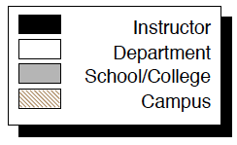
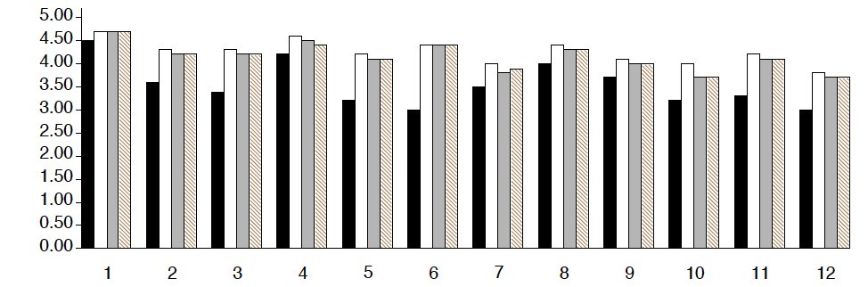
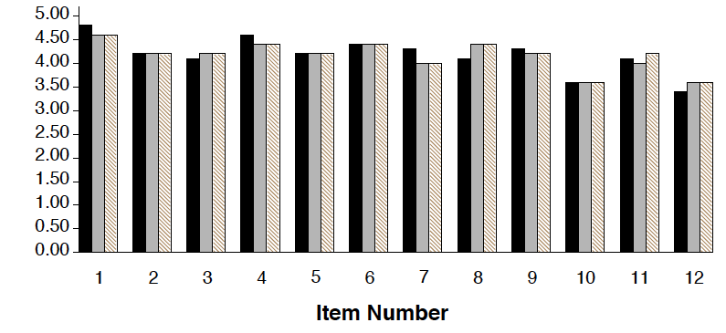
It works!
MICROBIO 480 Spring 2017
MICROBIO 480 Spring 2018
Notes:
(*1) The instructor was well prepared for class
(2) The instructor explained course material clearly.
(3) The instructor cleared up points of confusion.
(*4) The instructor used class time well.
(5) The instructor inspired interest in the subject matter of this course.
(6) The instructor showed a personal interest in helping students learn.
(*7) I received useful feedback on my performance on tests, papers, etc.
(8) The methods of evaluating my work were fair.
(*9) The instructor stimulated student participation.
(10) Overall, how much do you feel you learned in this course?
(*11) Overall rating of this instructor's teaching.
(12) Overall rating of this course.

Slide 5
Evidence-based STEM Teaching
Principles of Learning
  Prior Knowledge
  Knowledge Organization
  Motivation and Learning
  Practice and Feedback
Learning Objectives
Assessment
Active Learning
Inclusive Teaching
Notes:
Mental models that students carry into a new course can influence their perception of new information
Activating prior knowledge helps to address and change misconceptions

Slide 6
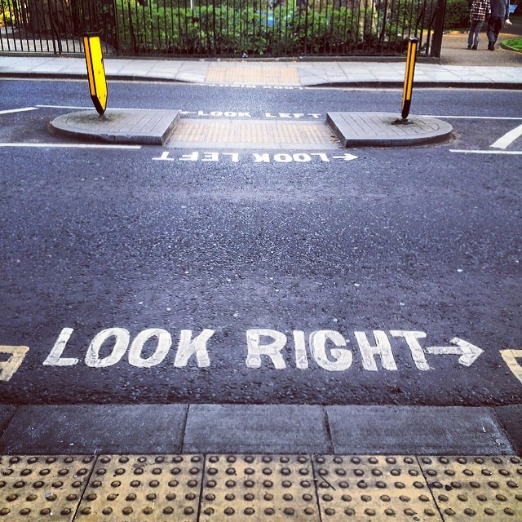
Week 1. Principles of Learning, Principle #1: Prior Knowledge
Mental models that students carry into a new course can influence their perception of new information
Activating prior knowledge helps to address and change misconceptions
Understanding typical types of misconceptions can help dispel them
Notes:
Prior knowledge can be thought of as the ornaments of a tree whose structure is the mental model, how it all fits together
Address erroneous mental models in order to provide students with an accurate mental representation of the concepts they will cover in the course
- Minute papers: ask students to write what they know about a future topic
- Alternating abstract and applied problems
- Peer instruction aka pair-and-share
- Pre-assessment quizzes (optional or for credit)

Slide 7
Categories of Misconceptions
Adapted from Chi & Roscoe (2002)
Easier to address
Proposition-Level Misconceptions
Flawed Mental Models
Ontological Miscategorizations
Embedded Beliefs
Harder to address

Slide 8
Proposition-Level Misconceptions
(Not true.)
Human Brain Power
Notes:
“fun facts” that are wrong
Knowing whether they are true or false does not affect your life or vision of yourself

Slide 9
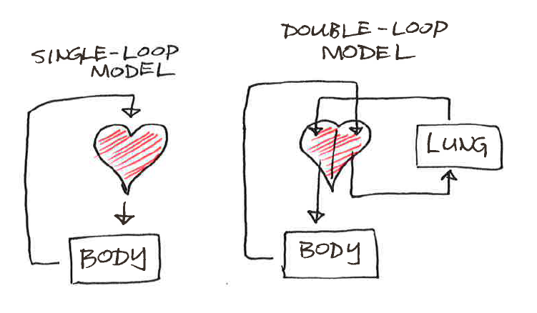
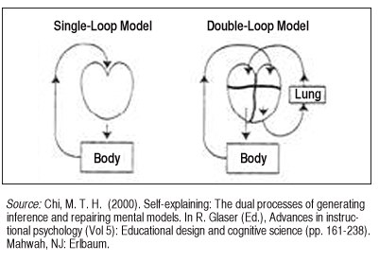
Flawed Mental Models
Chi (2000)
Notes:
Maybe students have the right metaphor, but the wrong application

Slide 10
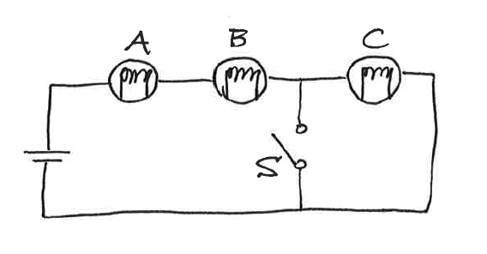
Ontological Miscategorizations
When the switch S is closed, what happens to the intensity of C?
It increases
It decreases
It stays the same
Mazur (1996)
Notes:
Ontology is the examination of what is meant by 'being’, and
deals with questions concerning what entities exist or may be said to exist and how such entities may be grouped, related within a hierarchy, and subdivided according to similarities and differences.
Having the wrong metaphor for the concept or lack of metaphor
The Prokaryotes

Slide 11
Ontological Miscategorizations
Which of the following represents a currently accepted model for the Tree of Life?
Bacteria
Archaea
Eukaryotes
Archaea
Bacteria
Eukaryotes
a.
c.
Archaea
Bacteria
Eukaryotes
b.
Notes:
Ontology is the examination of what is meant by 'being’, and
deals with questions concerning what entities exist or may be said to exist and how such entities may be grouped, related within a hierarchy, and subdivided according to similarities and differences.
The Prokaryotes

Slide 12

Embedded Beliefs

Slide 13
Principles of Learning, Principle #2: Knowledge Organization
The Big Picture
  Major versus minor concepts (“fun facts”)
  Connections between different concepts (e.g., connections between physiology and diversity)
  Conceptual understanding means the ability to solve new problems (e.g., PCR)
Notes:
Sometimes students and instructors view learning as a process of presenting information (that’s the instructor’s job) and memorizing that information (that’s the students’ job).
There’s strong evidence that deep learning requires much more than memorization, and yet memorization is still a focus of much of undergraduate STEM education.

Slide 14
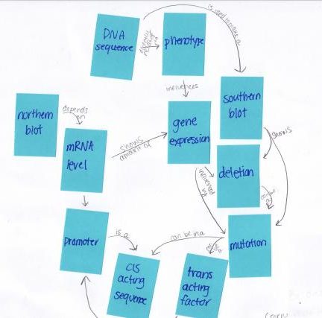
Principles of Learning, Principle #2: Knowledge Organization
To help give students the big picture
  Sign posts (“Think about how what we’re talking about today relates to this thing from last week.”)
  Concept maps
  Graphical syllabus
Notes:
Concept maps to identify the level and organization of student understanding as well as the importance of synthesizing information rather than simple memorization

Slide 15
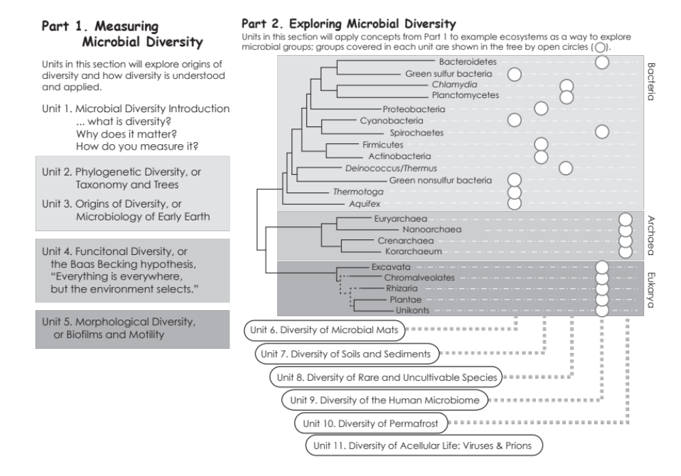
Notes:
100,000 Myxococcus xanthus and 10 Million E. coli cells. Timescale, a little less than 2 days (about 20 of 80 seconds of the original video, which was 7 days https://www.youtube.com/watch?v=tstc6doiNCU)

Slide 16
Principles of Learning, Principle #3: Motivation and Learning
The Cognitive Domain (How We Think)
The Affective Domain (How We Feel)
Notes:
Grades are not unimportant
Taking some of the pressure off can foster better learning and deep

Slide 17
What motivates an undergraduate student to learn?

Slide 18
Graduate School
Grades
Praise
Curiosity
Role Models
Parents
Jobs
Achievement
Social Issues
Fear of Failure
Money
Learning Itself
Teachers
Notes:
These are all intrinsic motivations
Extrinsic motivations come from incentives created by instructors, advisors, people of power

Slide 19
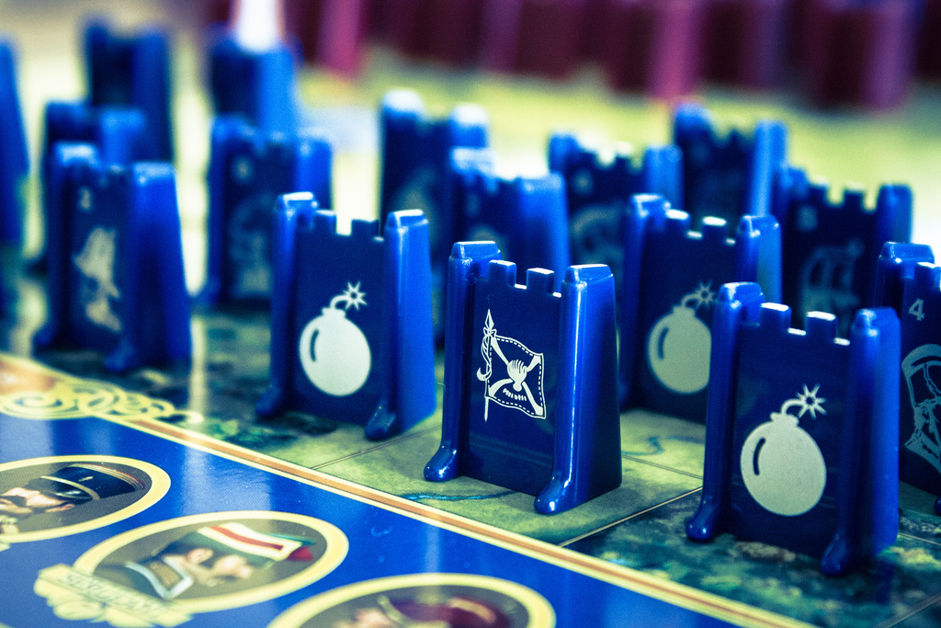
Strategic Learning
Bain (2004)
Notes:
What the best college teachers do – change the way students think, not WHAT they think but HOW

Slide 20

Deep Learning
Bain (2004)
Notes:
Not whether students can pass exams, but whether the education has sustained, substantial, positive influence on the way students think, act and feel
--> New conceptual understanding of the world

Slide 21
Principles of Learning, Principle #3: Motivation and Learning
If you want to inhibit the strategic learners, and shift their focus away from the grades and rewards, lower the stakes
  Multiple opportunities to show what they know
  Show what they know in different ways
  Less value to one Final Exam worth a lot of their grade
  Opportunities to revise and resubmit
  Build slack in the system: drop one problem set or quiz
  Not grade on the curve, which shifts away from deep learning and encourages strategic learning
  Social bookmarking = connect personal interests with class content, help students see they can learn from each other
Notes:
Grades are not unimportant
Taking some of the pressure off can foster better learning and deep

Slide 22
Principles of Learning, Principle #4: Practice and Feedback
To gain mastery of a subject, practice and feedback are required
  Unconscious incompetence (“wut”)
  Conscious incompetence (students become aware of what they don’t know)
  Conscious competence (building confidence, can talk their way through problems)
  Unconscious competence (the expert blind spot, topic feels automatic, old misconceptions are forgotten)
Notes:
Practice and feedback is critical in learning, the example is the popularity of the “flipped classroom”
The first time I saw my organic chemistry textbook
To students asking a question: what did you mean by that? Can you ask me a different way? Does anyone else know the answer?
Graduate students are the consciously competent: they know the materials well but remember the misconceptions they had to overcome.

Slide 23
Feedback from the instructor

Slide 24
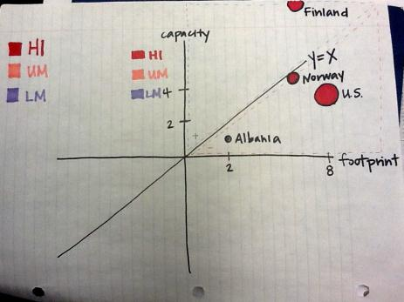
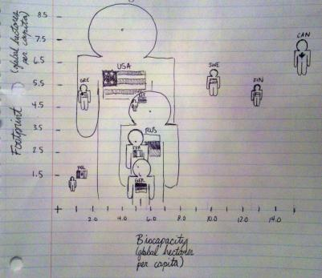
Doodles

Slide 25
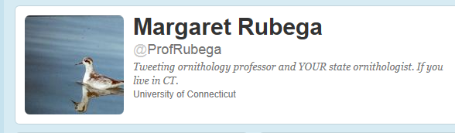
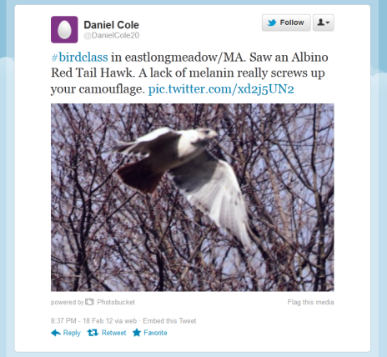
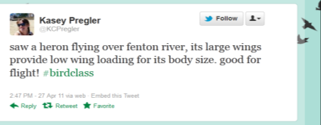
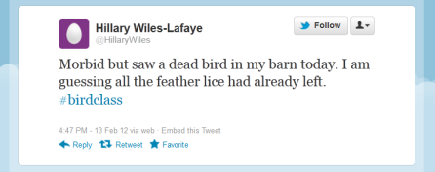
Fieldwork

Slide 26
Feedback from peers

Slide 27
Peer Instruction
Instructor Poses Question (<1 Min)
Students Answer Independently
(1-3 Min)
Instructor Views Results (<1 Min)
If Most Answer Correctly,
Briefly Discuss Question (1-3 Min)
If Most Answer Incorrectly,
Backtrack (5+ Min)
If Students Are Split, Have Students Discuss in Pairs and Revote
(1-5 Min)
Instructor Leads Classwide Discussion (2-15 Min)
Smith et al. (2009)

Slide 28
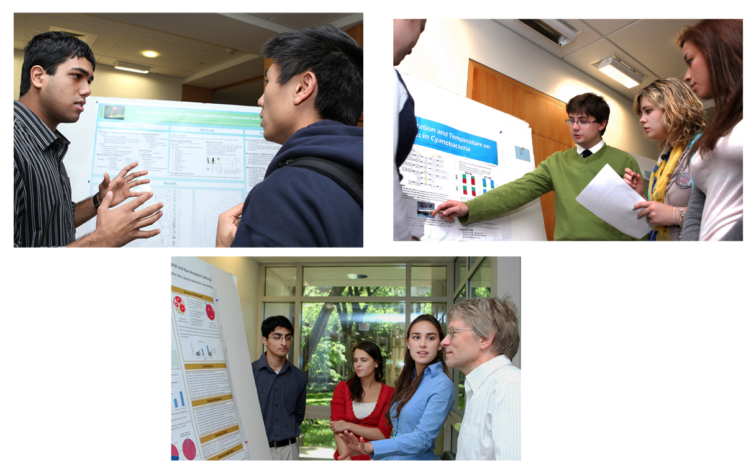
Peer Assessment

Slide 29
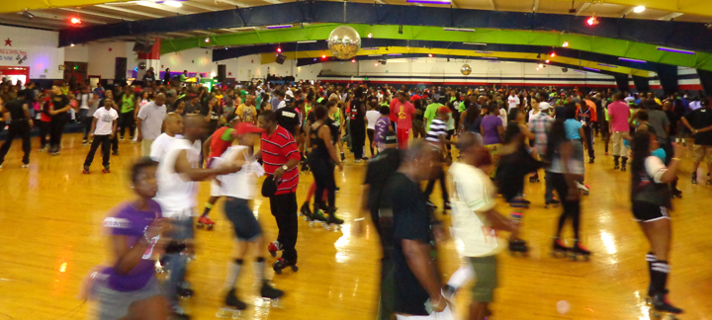
All-Skate
Classroom climate must allow for students to be wrong, sometimes for prolonged periods of time. Invite everyone to learn!

Slide 30
Principles of Learning, Principle #3: Practice and Feedback
From Instructors
  Clicker questions
  Test corrections
  Email doodles to the instructor
  Tweet (for an ornithology class, tweet a picture of a bird, where they saw it and connect it to class)
From peers
  Pair and share, poster sessions, peer review of work, in class presentations
From themselves
  Motivation and overcoming obstacles
Notes:
Cognitive domain: how we think
Affective domain: how we feel
Intrinsic versus extrinsic motivation
Competency: hard but not too hard
Autonomy: want choices
Purpose: what’s the goal

Slide 31
Evidence-based STEM Teaching
Outline
Principles of Learning
  Prior Knowledge
  Knowledge Organization
  Motivation and Learning
  Practice and Feedback
Learning Objectives
Assessment
Active Learning
Inclusive Teaching

Slide 32
Learning Objectives
What does it mean to understand?
Measureable things that students should be able to do after the class
Course-level Learning Goals
  Broad, big-picture, 5-10 per course
Lecture-level Learning Objectives
  More specific, 2-5 per learning goal

Slide 33
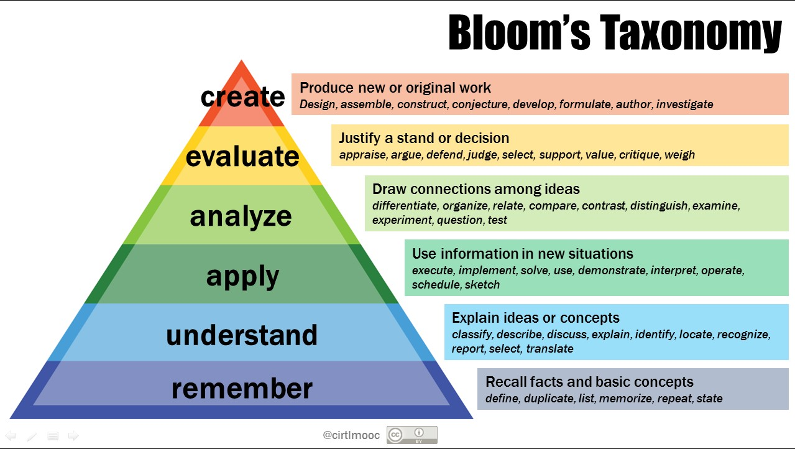
Learning Objectives
“By the end of this class/lecture, students should be able to…”
Notes:
There are different types of learning

Slide 34
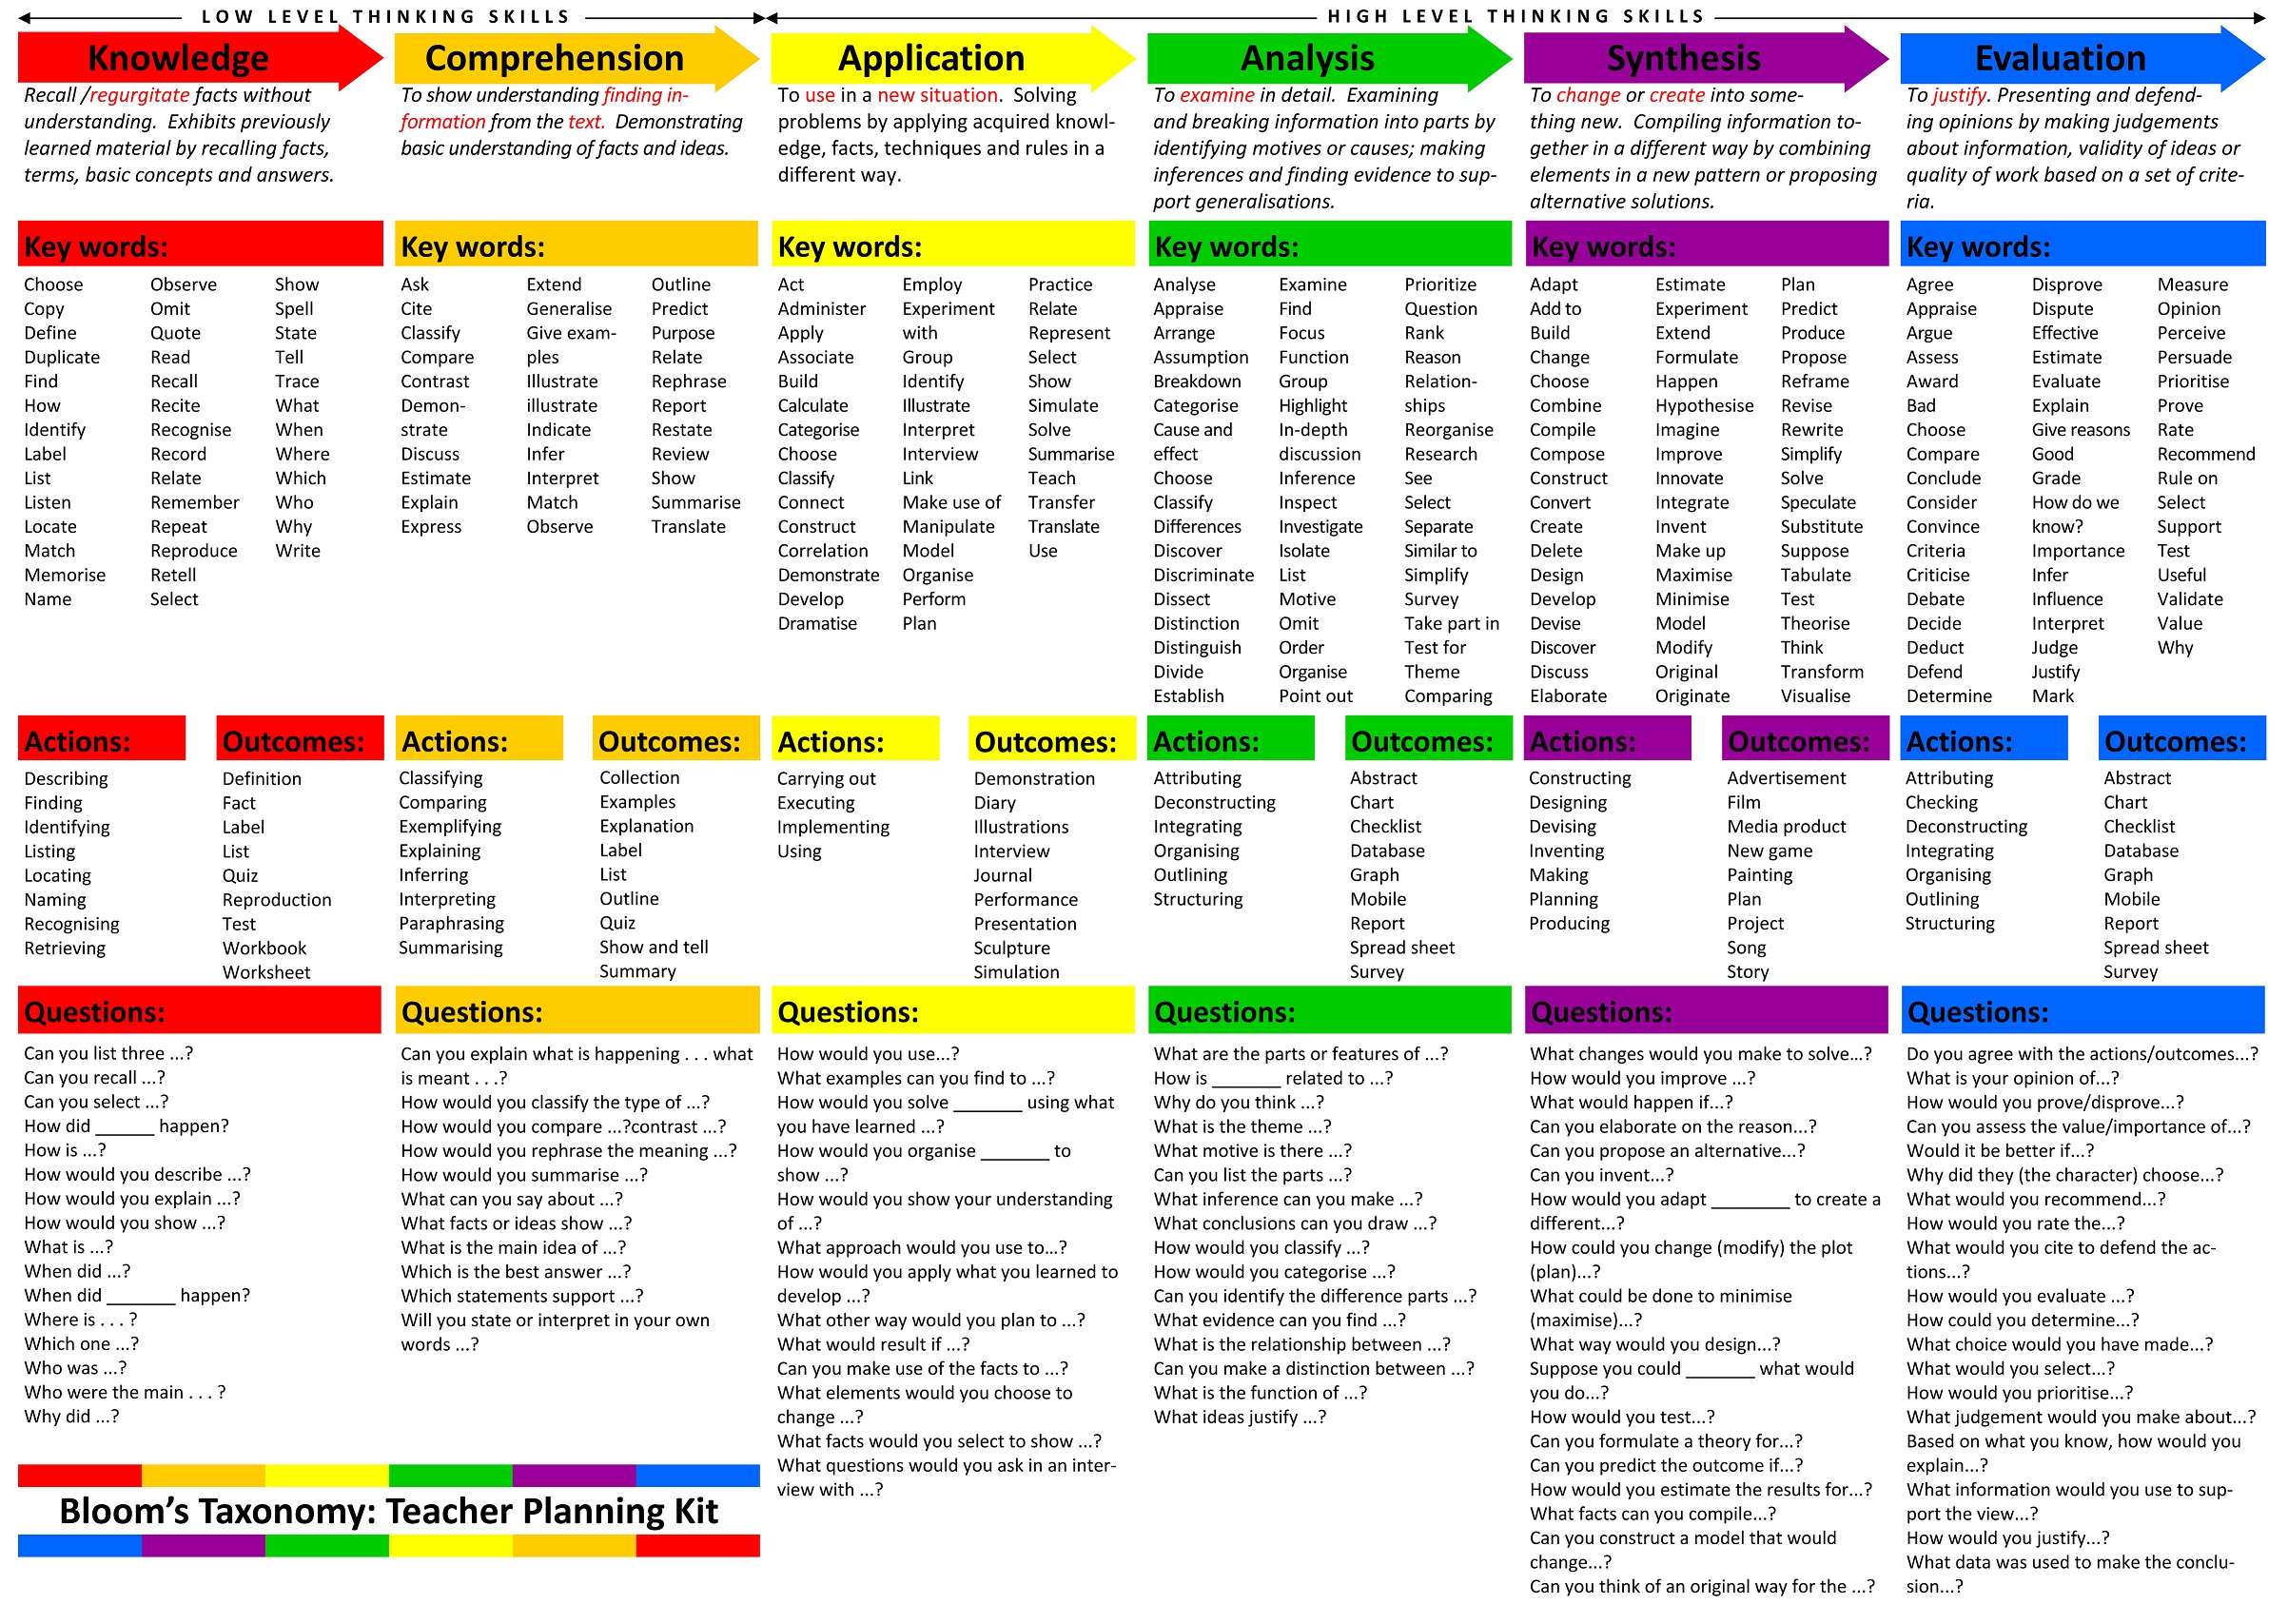
Bloom’s Taxonomy
Notes:
There are different types of learning

Slide 35
Check list for refining LOs
Is the goal expressed in terms of what the student will achieve or be able to do?
Is the goal well-defined? and measurable?
Is the terminology familiar? If not, is this a goal?
Does the LO goal align with the course goal?
Is the Bloom’s level appropriate? Are there a range of levels possible?
Do your goals cover the different types of knowledge?
Are your goals relevant and useful to students?

Slide 36
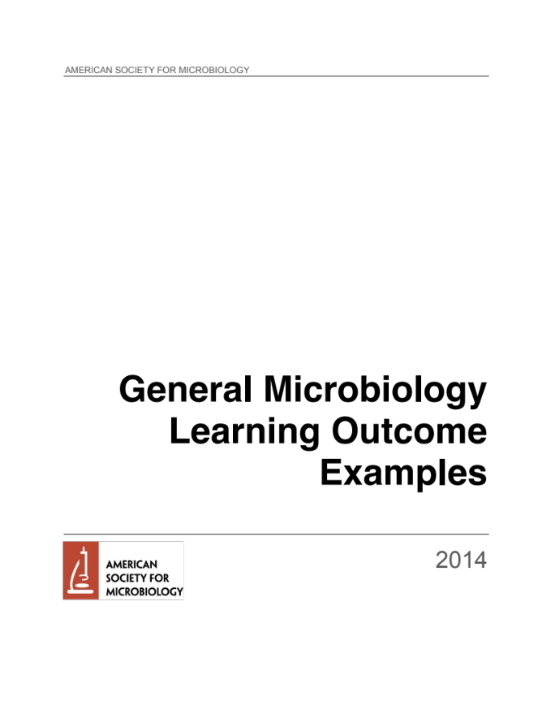

Learning Objectives
Backwards design:
(1) define LOs, then decide
(2) how to assess students based on LOs, then
(3) choose activities
(4) summarize topics covered.
Iterate as necessary.
Notes:
Drive instruction and assessment with learning goals

Slide 37
Evidence-based STEM Teaching
Outline
Principles of Learning
  Prior Knowledge
  Knowledge Organization
  Motivation and Learning
  Practice and Feedback
Learning Objectives
Assessment
Active Learning
Inclusive Teaching
Notes:
Who is it for?

Slide 38
Assessment: who is it for?
For the instructor
  Graded assignments
  “Monetary” reward can undermine intrinsic motivation (Murayama et al., 2010), but “monetary” value also signifies importance
For the student
  Revise and regrade, quizzes and others
Self-assessment

Slide 39
Self-assessment tool
Rubric by Jon Bender and adapted by Dimitri Dounas-Frazer, Geoff Iwata, John Haberstroh, and Joel Corbo for The Compass Project, University of California, Berkeley
Show you the tool
Have you use it
Have a student and instructor discuss one way of using it
Have you practice giving feedback using the tool
http://www.berkeleycompassproject.org/wordpress/wp-content/uploads/2012/12/Phys98_SelfEvalRubrics1.pdf or Coursera
Notes:
So now we'll take a look at an important tool to support students in identifying places for improvement and discuss some principles for giving constructive feedback with this tool.
And so first we'll show you the tool and then we'll have you use it a little in practice, so you get a sense of what it is.
10 minutes

Slide 40
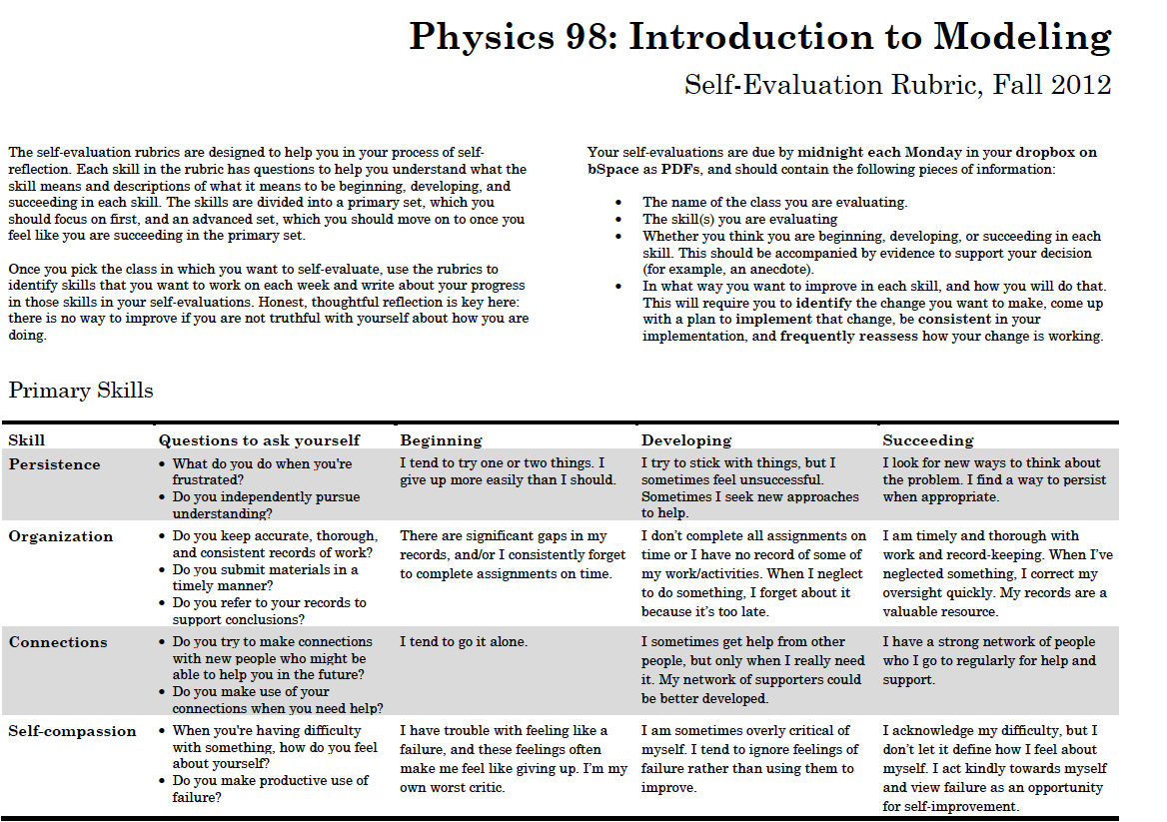
Notes:
And what you can see is that there's a descriptive list of some of the skills,
Primary skills

Slide 41
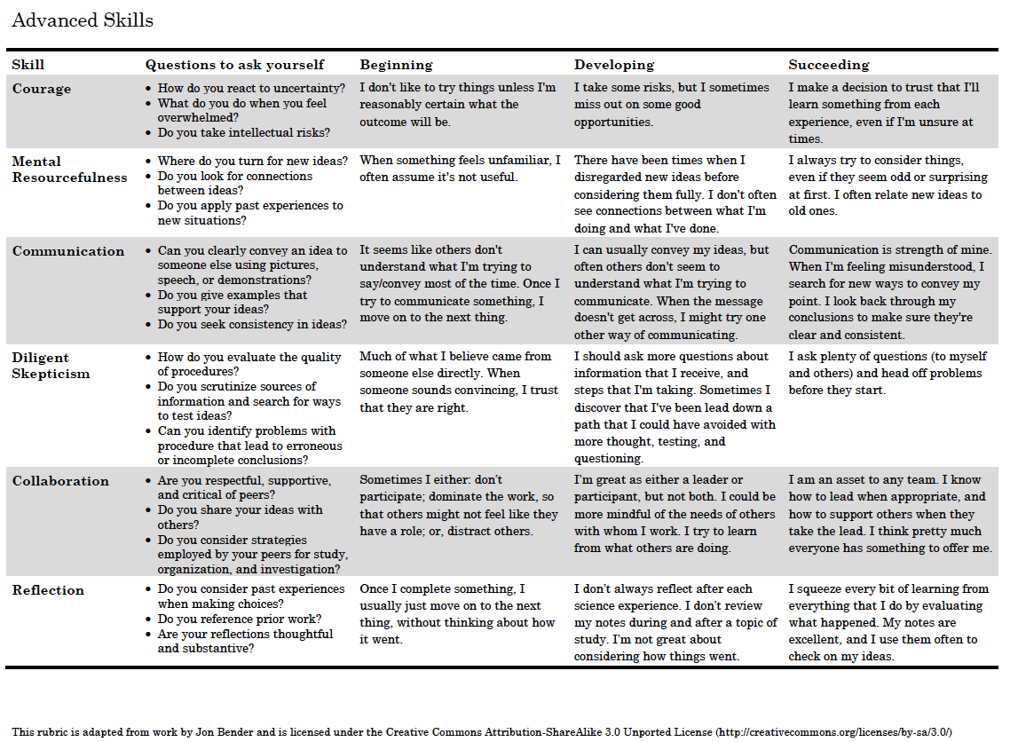
Notes:
And advanced skills

Slide 42
Notes:
that are really important to doing science, skills like collaboration and communication.

Slide 43
Notes:
And then there's some questions you can ask yourself
about how you're doing with respect to these skills.

Slide 44
Notes:
And then you can place yourself on a scale from beginning to succeeding.
So now let's zoom in on two more particular elements of the rubric -- mental resourcefulness and persistence.

Slide 45
Notes:
And so let's start out with persistence.
We see that the tool actually has some questions we can ask ourselves about persistence.
First, what do you do when you feel frustrated and do you independently pursue understanding?

Slide 46
Notes:
And then, there's a scale from beginning to succeeding and you might place yourself at the beginning part of the scale if you say that, "I tend to try one or two things
and I give up more easily than I should."
Whereas, you might be more at the succeeding level if you look for new ways to think about the problem and find ways to persist.

Slide 47
Rubric Journaling Activity
Step 1: Consider a course you are taking or a research project that you’re working on.
Step 2: Read over the rubric and pick one skill that you want to improve with respect to this research project or course (e.g. “persistence,” “communication,” “collaboration,” etc.)
Step 3: Journal for 5 minutes and
Identify whether you are beginning, developing, or succeeding at your chosen skill
Write a few sentences about how you are doing with the skill this week
Describe one or two concrete ideas for how you might improve.
http://www.berkeleycompassproject.org/wordpress/wp-content/uploads/2012/12/Phys98_SelfEvalRubrics1.pdf or Coursera
Notes:
Now take a moment to look over this rubric and pick one skill to journal on yourself
with respect to either a STEM course you're taking or a research project you're working on.
Discuss between student and instructor
Students pick one or two skills on the rubric
Students journal weekly with respect to an introductory physics or math course they are taking
Graduate Student Instructors provide feedback on weekly journal entries

Slide 48

Evidence-based STEM Teaching
Outline
Principles of Learning
  Prior Knowledge
  Knowledge Organization
  Practice and Feedback
Learning Objectives
Assessment
Active Learning
Inclusive Teaching

Slide 49
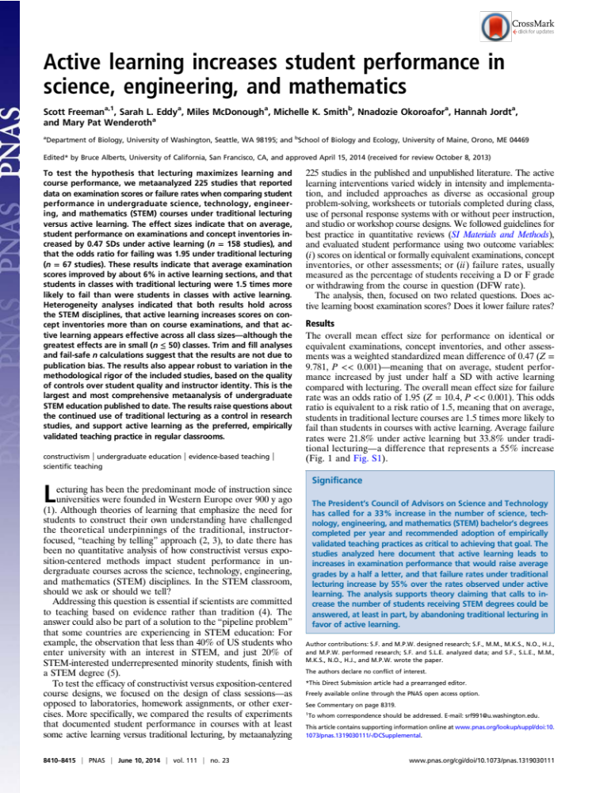
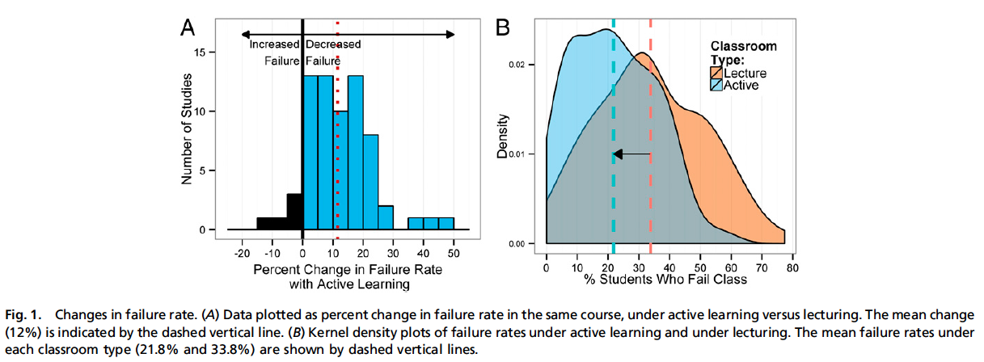
Notes:
Active learning is ”anything that involves students doing things and thinking about what they are doing” (Bonwell CC & JA Eison (1991). Active Learning: Creating excitement in the classroom. Washington, DC: The George Washington University, School of Education and Human Development.)
Meta-analysis of 225 studies that reported data on exam scores or failure rates when comparing student performance in undergraduate STEM courses under traditional lecturing versus active learning
student performance on examinations and concept inventories increased by 0.47 SDs under active learning (n = 158 studies),
and that the odds ratio for failing was 1.95 under traditional lecturing (n = 67 studies).
students in classes with traditional lecturing were 1.5 times more likely to fail than were students in classes with active learning

Slide 50
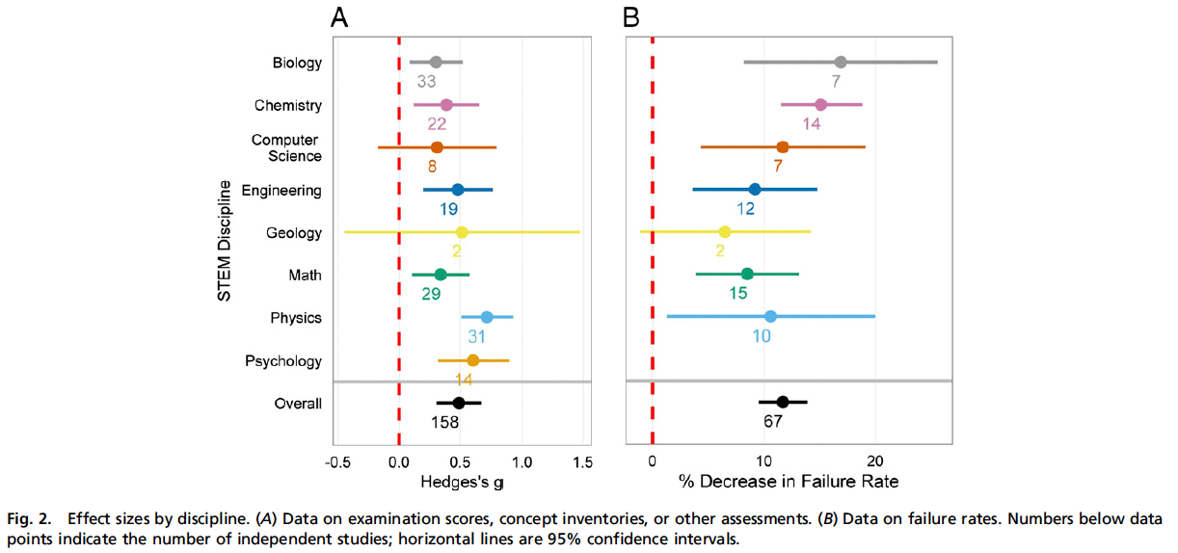
Notes:
These resutls in improved exam scores (A) and reduced failure rate (B) worked regardless of discipline

Slide 51
ACTIVE LEARNING
Critical Thinking
Problem Based Learning
Inquiry Based Labs
Teamwork
Cooperative Learning
Peer Instruction
Notes:
Assessment

Slide 52
ACTIVE LEARNING
Critical Thinking
Problem Based Learning
Inquiry Based Labs
Teamwork
Cooperative Learning
Peer Instruction
Problem-based learning (PBL) is a teaching approach that challenges students to learn concepts/principles by applying them to real-life problems.
Notes:
Problem-based learning (PBL) is a teaching approach that challenges students to learn concepts/principles by applying them to real-life problems.
- new vaccines or new antibiotics
- alien worlds or extreme environments
-

Slide 53
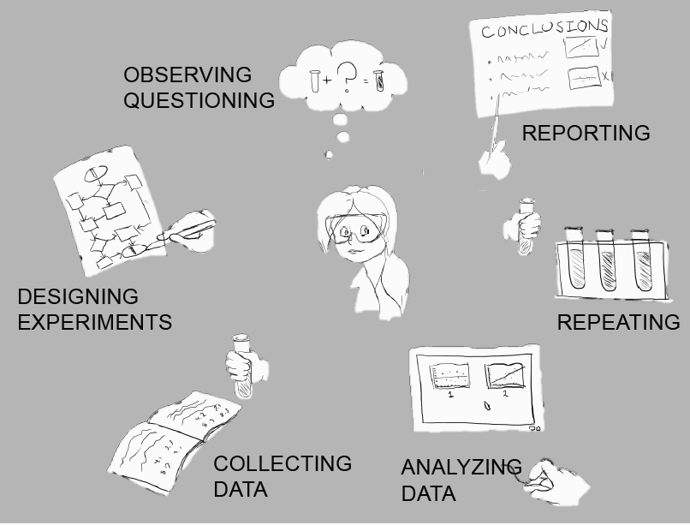
ACTIVE LEARNING
Critical Thinking
Problem Based Learning
Inquiry Based Labs
Teamwork
Cooperative Learning
Peer Instruction
In inquiry-based labs, students “engage in many of the same activities and thinking processes as scientists.”
Notes:
In inquiry-based labs, students “engage in many of the same activities and thinking processes as scientists.”
CURE = course-based undergraduate research experience

Slide 54
ACTIVE LEARNING
Critical Thinking
Problem Based Learning
Inquiry Based Labs
Teamwork
Cooperative Learning
Peer Instruction
Cooperative learning is “the instructional use of small groups so that students work together to maximize their own and each other’s learning”
Notes:
Cooperative learning is “the instructional use of small groups so that students work together to maximize their own and each other’s learning”

Slide 55
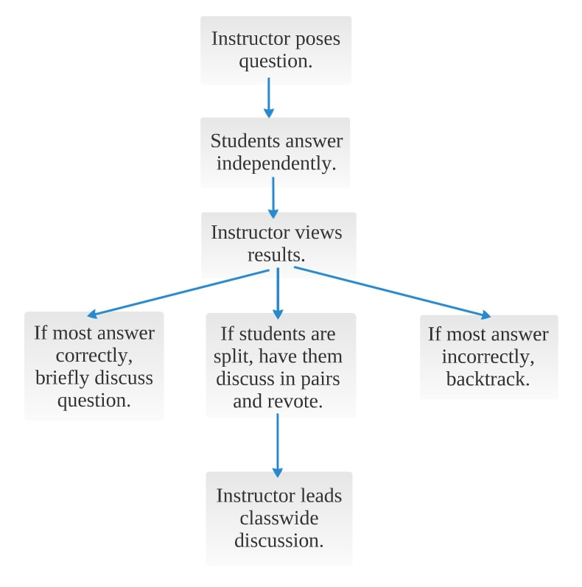
ACTIVE LEARNING
Critical Thinking
Problem Based Learning
Inquiry Based Labs
Teamwork
Cooperative Learning
Peer Instruction
Notes:
Assessment
positive interdependence “sink or swim”
individual and group accountability
face-2-face interactions
teamwork skills
group processing and facilitation
Next steps: read paper,

Slide 56
Evidence-based STEM Teaching
Outline
Principles of Learning
  Prior Knowledge
  Knowledge Organization
  Motivation and Learning
  Practice and Feedback
Learning Objectives
Assessment
Active Learning
Inclusive Teaching

Slide 57
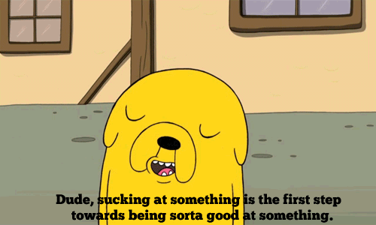
For more inclusive teaching, normalize struggle.
"Growth mindset” vs "Fixed mindset”
Blackwell, Lisa S., Kali H. Trzesniewski, and Carol Sorich Dweck. "Implicit theories of intelligence predict achievement across an adolescent transition: A longitudinal study and an intervention." Child development 78.1 (2007): 246-263.
Notes:
Blackwell et al.
(1) Surveyed 373 rising 7th graders about mindset, then followed their progress; all entered with about the same level of achievement, but students with growth mindset jumped ahead of those with fixed mindset after a few months and continued to diverge for up to 2 years
(2) Intervention for students with declining math grades, where ” students were taught that the brain is like a muscle that grows stronger with use, and that every time they stretched themselves and learned something new their brain formed new connections.” Students with the intervention had a clear rebound.
Students with the growth mindset tend to orient more toward learning goals and students with the fixed mindset tend to orient more toward validating their intelligence
Praise that mostly has a growth mindset framing (e.g. improving skills)
For independent study, assessment based on progress not results
Normalize struggle

Slide 58
    Tone
    Ishiyama & Hartlaub (2002)
Syllabus study
Randomly assigned students a punishing (“graded down 20%”) or rewarding syllabus (“only be eligible for 80% of the total points”).
Significant difference in perceived approachability, desire to take the course
  Less comfortable going to instructor with punishing wording for help
  First year students most affected by wording
Notes:
Punishing: “If for some substantial reason you cannot turn in your papers or take an exam at the scheduled time
you must contact me prior to the due date, or test date, or you will be
graded down 20%”
Rewarding: “If for some substantial reason you cannot turn in your papers or take an exam at the scheduled time
you should contact me prior to the due date, or test date, or you will
only be eligible for 80% of the total points.”

Slide 59
Personal Interactions
Astin (1997)
“Faculty Student Orientation:” Student perceptions of whether faculty
are interested in students’ academic problems
are approachable outside of class
treat students as persons and not as numbers
care about the concerns of minority groups
positively impacts
self-reported critical thinking, analysis, and problem-solving skills
retention
percentage of students who go on to graduate school
Notes:
Seymour and Hewitt (1997) found that one of the reasons students switch from the sciences is faculty unavailability, and that, conversely, one of the variables that changed the minds of students who were thinking about switching was the intervention by a faculty member during a critical point in the student’s academic or personal life.
Pascarella and Terenzini (1977) discovered that the absence of faculty contacts or the perception that those are largely formalistic exchanges is one of the determinants of student withdrawal from college.

Slide 60
Some guiding principles/strategies
Examine your assumptions
Learn and use students’ names
Model inclusive language
Use multiple and diverse examples
Establish ground rules for interaction
Strive to be fair
Be mindful of low ability cues
Don’t ask people to speak for an entire group
Be careful about microinequities

Slide 61
Microinequities
Hall and Sandler (1982, 1993)
Male students
tend to get more eye contact
are called on more
get more praise for answers
are asked more follow-up questions
have their names used more
and are more regularly given credit for their contributions
…by generally well-meaning male AND female instructors.
Notes:
Hall, Roberta M., and Bernice R. Sandler. "The Classroom Climate: A Chilly One for Women?." (1982).
APA

Slide 62
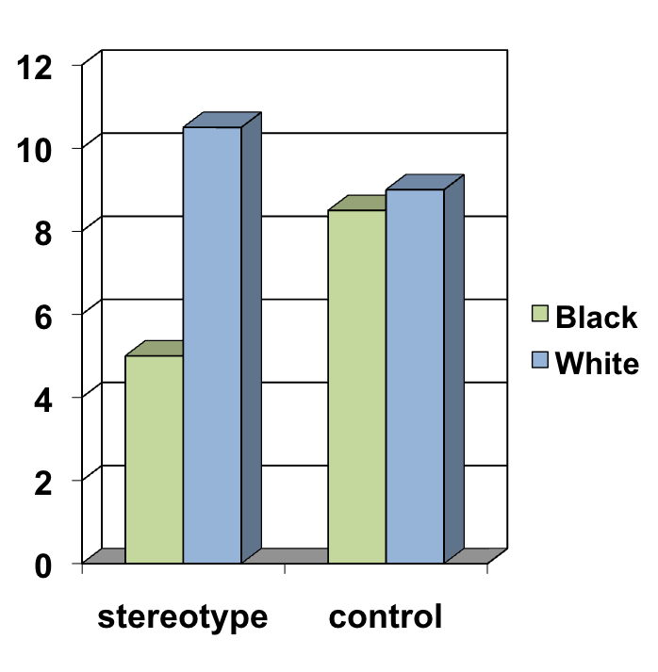
Stereotype Threat
Steele and Aronson (1995)
Simply activating an academic stereotype for a minority group before a test produces a decrement in performance!!
Notes:
Situational threat – different from stigma
Acute, sometimes chronic, pressure in students’ lives
Needs some conditions:
Stereotype becomes relevant as a possible explanation of one’s performance
Task poses a challenge to the person
The outcome of the task is important to the person in terms of “self-definition”
⇦Academic vanguard of the targeted group
The person does not need to believe the stereotype

Slide 63
Stereotype inoculation: representation matters
women’s own self-concept benefited from contact with female experts even though negative stereotypes about their gender and STEM remained active
Stout, J. G., Dasgupta, N., Hunsinger, M., & McManus, M. A. (2011). STEMing the tide: using ingroup experts to inoculate women's self-concept in science, technology, engineering, and mathematics (STEM). Journal of personality and social psychology, 100(2), 255

Slide 64

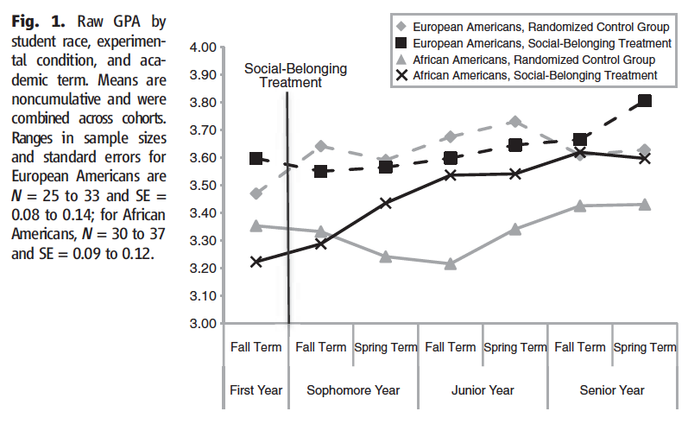
Notes:
The intervention aimed to lessen psychological perceptions of threat on campus by framing social adversity as common and transient.
Members of socially stigmatized groups, such as African Americans, may be relatively more uncertain about their social belonging in main- stream institutions like school and work
several steps exploited the “saying- is-believing effect”—the tendency to endorse messages that one has freely advocated
- students wrote and recorded a speech for future students about the transient nature of not belonging
targeted intervention can have broad consequences that lessen inequalities in achievement and health

Slide 65
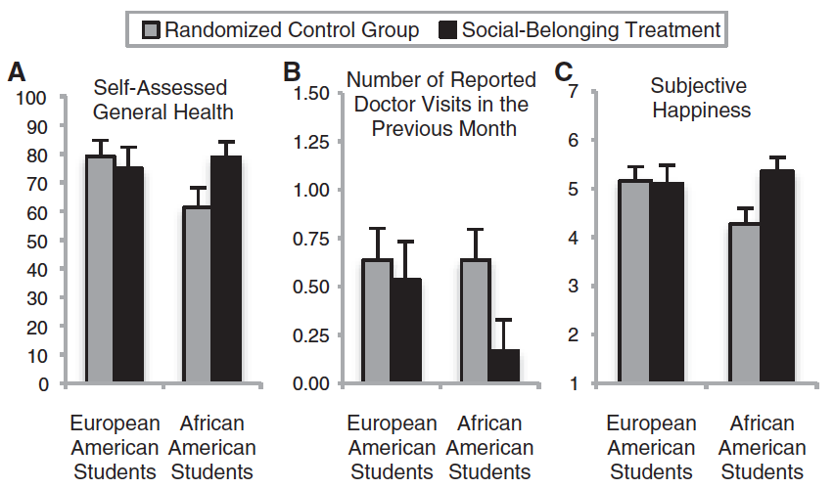
Notes:
The intervention aimed to lessen psychological perceptions of threat on campus by framing social adversity as common and transient.
Members of socially stigmatized groups, such as African Americans, may be relatively more uncertain about their social belonging in main- stream institutions like school and work
several steps exploited the “saying- is-believing effect”—the tendency to endorse messages that one has freely advocated
- students wrote and recorded a speech for future students about the transient nature of not belonging
targeted intervention can have broad consequences that lessen inequalities in achievement and health

Slide 66
Implicit bias
EVERYONE HAS BIAS… Know your own.
  https://implicit.harvard.edu/self-assessment
Stereotype threat and stereotype inoculation
  Representation matters
  Stout, Dasgupta et al (2011)
Racial spotlighting and racial ignoring
  Additional stresses on minority students
  Carter Andrews D (2012)
Notes:
women’s own self-concept benefited from contact with female experts even though negative stereotypes about their gender and STEM remained active

Slide 67

Intervention #1: Integrate culturally inclusive and relevant content (“decolonize your syllabus”)
#2: Decrease the potential intimidation students feel towards instructors
#3: Get students involved with supplemental instruction
#4: Be intentional about how student groups and project teams are formed (CATME).
#5: Work with TAs and other instructors in class.
#6: Use inclusive teaching practices.
Notes:
#6. Make sure the classroom, textbooks, handouts, and all other course materials reflect an inclusive environment in both their content and images (Billings, 2008).
Set clear norms of behavior and communication that reflect respect and understanding in the classroom, as well how to communicate differences of opinion (Billings, 2008). Discuss these norms with students at the beginning of the course, and review them as needed.
Include activities that help students understand their own cultures and values as well as those of their peers (Billings, 2008).
Address relevant, real-world issues in an action-oriented manner (Wlodkowski, 1995).
Emphasize the human purpose of what is being learned and its relationship to the students' experience (Wlodkowski, 1995).
Encourage students to make choices in content and assessment methods based on their experiences, values, needs, and strengths.

Slide 68
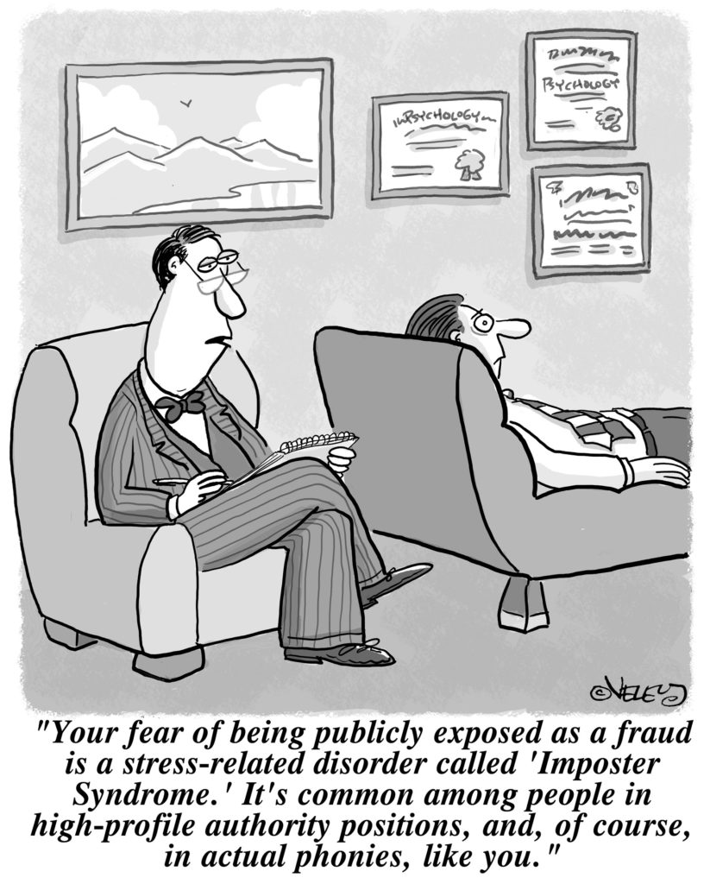
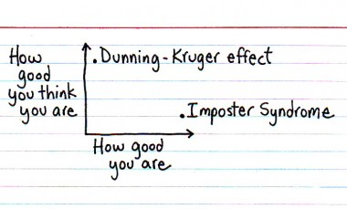
Imposter syndrome
Notes:
a psychological pattern in which people doubt their accomplishments and have a persistent, often internalized fear of being exposed as a "fraud".

Slide 69
Evidence-based STEM Teaching
Principles of Learning
  Prior Knowledge
  Knowledge Organization
  Motivation & Learning
  Practice and Feedback
Learning Objectives
Assessment
Active Learning
Inclusive Teaching
Describe the 8-week CIRTL MOOC An Introduction to Evidence-Based Undergraduate STEM Teaching.
Identify some tools that you can use to improve STEM learning outcomes for undergraduate students.
Feel enabled to incorporate one or two new ideas into your teaching.

Slide 70
References
Bain, K. "What the best college teachers do. 2004." Cambridge, MA: Harvard (2004).
Blackwell, Lisa S., Kali H. Trzesniewski, and Carol Sorich Dweck. "Implicit theories of intelligence predict achievement across an adolescent transition: A longitudinal study and an intervention." Child development 78.1 (2007): 246-263.
Bonwell CC & JA Eison (1991). Active Learning: Creating excitement in the classroom. Washington, DC: The George Washington University, School of Education and Human Development.
Carter Andrews, Dorinda J. "Black achievers’ experiences with racial spotlighting and ignoring in a predominantly White high school." Teachers College Record 114.10 (2012): 1-46.
Chi, Michelene TH, and Rod D. Roscoe. "The processes and challenges of conceptual change." Reconsidering conceptual change: Issues in theory and practice. Springer, Dordrecht, 2002. 3-27.
Chi, M. "Self-explaining expository texts: The dual processes of generating inferences and repairing mental models." Advances in instructional psychology 5 (2000): 161-238.
Dweck, Carol S. "Mindsets and math/science achievement." (2014).
Freeman, S., Eddy, S. L., McDonough, M., Smith, M. K., Okoroafor, N., Jordt, H., & Wenderoth, M. P. (2014). Active learning increases student performance in science, engineering, and mathematics. Proceedings of the National Academy of Sciences, 111(23), 8410-8415.
Hall, Roberta M., and Bernice R. Sandler. "The Classroom Climate: A Chilly One for Women?." (1982).
Ishiyama, John T., and Stephen Hartlaub. "Does the wording of syllabi affect student course assessment in introductory political science classes?." PS: Political Science & Politics 35.3 (2002): 567-570.
Mazur, E. (1996). Peer instruction: A user’s manual. Upper Saddle River, NJ: Prentice Hall.
Murayama, K., Matsumoto, M., Izuma, K., & Matsumoto, K. (2010). Neural basis of the undermining effect of monetary reward on intrinsic motivation. Proceedings of the National Academy of Sciences, 107(49), 20911-20916.
Steele, C. M., & Aronson, J. (1995). Stereotype threat and the intellectual test performance of African Americans. Journal of personality and social psychology, 69(5), 797.
Stout, J. G., Dasgupta, N., Hunsinger, M., & McManus, M. A. (2011). STEMing the tide: using ingroup experts to inoculate women's self-concept in science, technology, engineering, and mathematics (STEM). Journal of personality and social psychology, 100(2), 255.
Walton, G. M., & Cohen, G. L. (2011). A brief social-belonging intervention improves academic and health outcomes of minority students. Science, 331(6023), 1447-1451.
Yeager, David Scott, and Carol S. Dweck. "Mindsets that promote resilience: When students believe that personal characteristics can be developed." Educational psychologist 47.4 (2012): 302-314.

